Slide 1
Technological Affordances: An Instructional Unit
Sarah packet
EDIS 7000

Slide 2
Designer Notes
All include narration which is scripted in the notes section at the bottom of each slide.
All slide headings are are in Gill Sans MT (Heading) font, size 28 and all slide body text are in Gill Sans MT (Body) font, size
Each slide will use the same style template based on its purpose: introduction template title page, new section, content, assessment slides
Color scheme should remain the same throughout.
Colors should be professional and easy on the eyes.

Slide 3
Technological Affordances
Design Note: Only the first 4 modules have been mapped out within this storyboard.
Considerations FOR integrating technology into instructional designs
Navigation Note: A navigation arrow will appear at the bottom of each slide. Clicking this arrow will take learners to the next slide.
Notes:
Slide Purpose: Introduction slide with title
Narration: “This instructional unit is about technological affordances and their impact on technology selection and integration within the instructional design process. To begin this unit hit the grey arrow at the bottom right of the screen”
Navigation Notes: Narration will begin as soon as the e learning unit begins. Once the narrations has ended, learners will be prompted to hit the grey arrow which will take them to the next slide.
Design Notes: Title

Slide 4
purpose of This unit
This unit is beneficial to those who are considering integrating technology within their instructional designs.
Multimedia Effect: Images of professionals integrating technology go here. These images align with the narration and demonstrate professionals who may benefit from this instructional unit.
Notes:
Slide Purpose: Describe who may benefit from this unit.
Narration: “This unit could be helpful to professionals who develop instruction and are considering the use of the technology into that design. There are a variety of professionals who may find his unit useful: educators, instructional designers, trainers, consultants. However, any student or professional who is considering the use of technology within their design process could find this information useful.
Navigation Notes: Click bottom right arrow when narration ends to move to the next slide.
Design Notes: Content Slide Template

Slide 5
Learning Outcomes
After this unit you will be able to…
Design Note: Only objectives 1-4 were developed within this storyboard
Objective 1
Objective 2
Objective 3
Objective 4
Objective 5
Objective 6
Design Note: Each learning objective will appear, one at a time, as the narration introduces it.
Notes:
Slide Purpose: Layout learning objectives for this unit.
Narration: “After completing this unit you will be able to define and explain affordances, explain the significance of technological affordances within the instructional design process, identify technological affordances when evaluating technologies, determine the need for technology, if any, after analyzing the needs within your own designs.”
Navigation Notes: Click bottom right arrow when narration ends to move to next slide.
Design Notes: Content Slide Template

Slide 6
Modules within this unit
Affordances & Constraints
Technological Affordances & Constraints
Instructional Design Decisions
Instructional & Learner Analysis
Technology Selection
Technology Integration
Design Note: Only the first 4 modules have been mapped out within this storyboard.
Notes:
Slide Purpose: Overview of instructional modules included in this instructional unit.
Narration: “Here are the topics that are being covered within this instructional unit.”
Navigation Notes: Click bottom right arrow when narration ends to move to the next slide.
Design Notes: New Section Template

Slide 7
Affordances and Constraints
Affordances & Constraints
Technological Affordances & Constraints
Instructional Design Decisions
Instructional & Learner Analysis
Technology Selection
Technology Integration
Notes:
Slide Purpose: Module 1 introduction
Narration: “We begin with affordances and constraints.”
Navigation Notes: Click bottom right arrow when narration ends to move to the next slide.
Design Notes: New Section Template

Slide 8
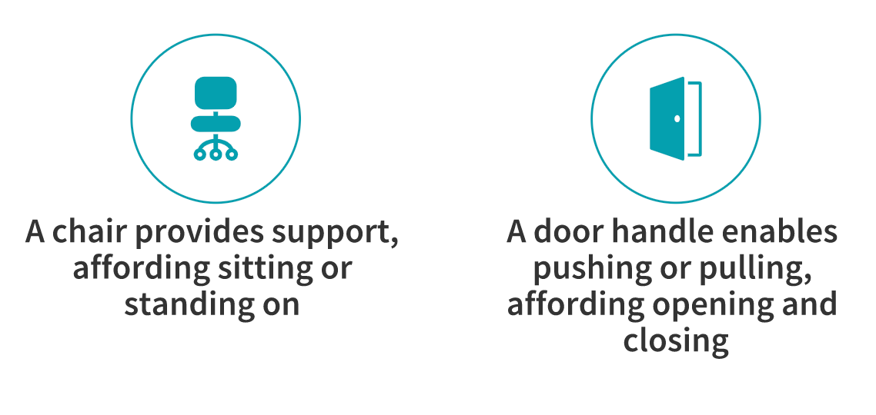
What are affordances?
“Affordances are clues in the environment that indicate possibilities for action” according to James J. Gibson (1966)
Multimedia Effect: insert images that represent these examples
Notes:
Slide Purpose: Define affordances and provide examples of affordances with images.
Narration: ”Before we start talking about technological affordances, let’s begin with defining affordances. What are affordances? According to James J. Gibson, affordances are clues in the environment that indicate possibilities for action.” What this means is that objects, items, or tools provide opportunities for actions to occur. For example, a chair provides support, therefore it allows, or affords the ability for someone to sit or stand on it. A door handle enables pushing or pulling which affords opening or closing.”
Navigation Notes: Click bottom right arrow when narration ends to move to the next slide.
Design Notes: Content Slide Template

Slide 9
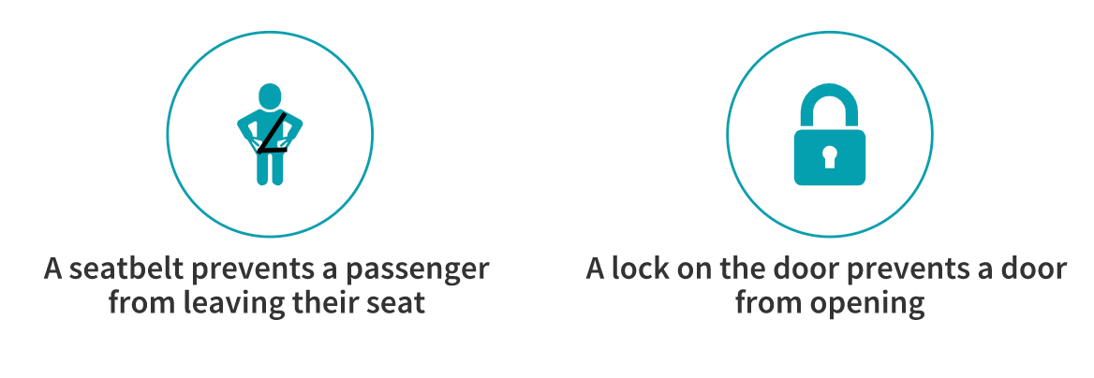
What are constraints?
Constraints are what you cannot do with a tool, technology, or object.
Multimedia Effect: insert images that represent these examples
Notes:
Slide Purpose: Define constraints and provide examples of constraints with images.
Narration: “Now that we have reviewed affordances, what we can do with an object, let’s take a look at objects that prevent us from a specific action. These are known as constraints. Constraints are what you cannot do with a tool, technology, or an object. For example a seatbelt prevents a passenger from leaving their seat and a lock on the door prevents a door from opening. Now that we have looked at both affordances and constraints, let’s look at some practice scenarios.”
Navigation Notes: Click bottom right arrow when narration ends to move to the next slide.
Design Notes: Content Slide Template

Slide 10
Affordances vs Constraints Quick Check
Multimedia Effect: Clickable button to read aloud assessment question
Campers light a fire on a cold night and cook dinner on the flame. In this scenario does the fire serve as an affordance or a constraint?
A captain lets down his anchor and the boat cannot move. In this scenario does the anchor serve as an affordance or a constraint?
Multimedia Effect: Images of flame and anchor that support the assessment question
Affordance
Constraint
Design Note: Students will click the white box to submit their answer choice.
Affordance
Constraint
Notes:
Slide Purpose: Assessment for objective 1--students will identify examples and non examples (constraints) of affordances
Narration: “Here we have two scenarios. Read each scenario and determine if that object acts as an affordance or constraint. Once you have selected both answers, hit the next arrow on the bottom right corner of your screen to submit your answers.”
Navigation Notes: Once narration ends, click an answer for the top question and the bottom question. Once two answers have been selected, click bottom right arrow to go to the answer key.
*In the event, the user gets these answer incorrect they will be sent back to review the definitions and examples and then take another affordance and constraint quick check with two different scenario questions.
Design Notes: Assessment Slide Template

Slide 11
Affordances vs Constraints Answer Key
The fire serves as an affordance. It provides heat and light so that the campers can cook, stay warm, or see in the dark
The anchor serves as a constraint. When the captain puts down his anchor it prevents the boat from moving.
Designer Note: The answer key will provide explanations for why each answer is correct.
Notes:
Slide Purpose: Assessment answer key for previous slide, objective 1
Narration: “As you can see for the first scenario, fire served as an affordance. It provided heat and light which could allow campers to cook, stay warm, and see in the dark. As for the next scenario, the anchor served as a constraint. Once the anchor was used it prevented the boat from moving through the water. Now let’s discuss affordances and constraints in regard to technology.”
Navigation Notes: Click bottom right arrow when narration ends to move to the next slide.
Design Notes: Assessment Slide Template

Slide 12
Technological affordances and constraints
Affordances & Constraints
Technological Affordances & Constraints
Instructional Design Decisions
Instructional & Learner Analysis
Technology Selection
Technology Integration
Notes:
Slide Purpose: Introduction for module 2
Narration: “Now we will discuss technological affordances and constraints.”
Navigation Notes: Click bottom right arrow when narration ends to move to the next slide.
Design Notes: New Section Template
:

Slide 13
technological Affordances and Constraints
Technological affordances are the features or action potentials provided by a technology
Technological constraints prevent learners from doing something using technology
Notes:
Slide Purpose: Provide definitions of technological affordances and technological constraints
Narration: ”Technological affordances are the features or action potentials provided by a technology. This definition is very similar to Gibson’s definition or affordances, but applies it with a technological lens. Technological constraints use technology to prevent learners form doing something. Let’s see what technological affordances and constraints look like.”
Navigation Notes: Click bottom right arrow when narration ends to move to the next slide.
Design Notes: Content Slide Template

Slide 14
Technological Affordances Action Capabilities
Media Affordances
video, recordings, visuals, read aloud, speaking, writing, drawing
Spatial Affordances
resizing, moving, dragging
Temporal Affordances
playback, recording, synchronous
Navigational Affordances
browse, search, links, data manipulation
Emphasis Affordances
highlight, focus
Multimedia Effect: Images to go with each type of affordance.
Notes:
Slide Purpose: Provide examples of technological affordances with action capabilities with images
Narration: “When evaluating technology, there are a variety of affordances it can offer. Some examples are how you can use technology to achieve a variety of actions.
-The first example are Media affordances which can allow the user to post videos, recordings, visual images. This technology could also allow for text to be read aloud, as well as for users to record, write, or draw.
-Spatial affordances allow the user to manipulate or change components—allowing instructors or learners to resize, move or drag objects.
-Temporal Affordances– this regards the technology’s ability to playback or record the instruction, as well as the technology’s ability to provide synchronous access
Navigational Affordances– these are features that allow instructors and users to browse, search, or link resources.
Emphasis Affordances--here a technology can provide opportunities to highlight or focus on significant information or components.
Navigation Notes: Click bottom right arrow when narration ends to move to the next slide.
Design Notes: Content Slide Template

Slide 15
Technological Affordances Utility Capabilities
Multimedia Effect: Images to go with each type of affordance.
Interactivity
Adpativity
Feedback
Choice
Non Linear Access
Linked Representation
Open Ended
Communication
Multimedia Effect: Examples of each technological affordance will appear as you hover over each example.
Notes:
Slide Purpose: Provide examples of technological affordances with utility capabilities with images
Narration: “Here are examples of technological affordances and how instructors can select technology based on their utility capabilities. Instructors might select technology because they may be looking for technologies that afford the following:
Interactivity between the instructor and peers.
Adaptivity, technology that adjust to the individual learner’s needs
Feedback capabilities, the ability to give or receive feedback from instructors or peers
Choice options, technology that allows learners to choose from lessons or activities
Non-Linear Access, the ability to access the information whenever the learner prefers or at whatever starting point the user would like
Linked Representation, which allows for multiple forms of representation to present content, such as spoken text to go with an image
Open ended technologies that provide opportunities for written or drawn responses from learners.
Communication, technologies that have features that allow for written or verbal communication, such as with email or discussion rooms.”
Navigation Notes: After the narration ends. Hover over each category to explore the different examples, the click bottom right arrow when narration ends to move to the next slide.
Design Notes: Content Slide Template

Slide 16
Technological Constraints
Multimedia Effect: insert images that represents a technological constraint
For example, you may consider technologies that...
keep learners from accessing certain sites
limit chat features during synchronous instruction
restrict access to some resources or materials
Notes:
Slide Purpose: Provide examples of technological constraints
Narration: “However, when we consider selecting technology to integrate into our instruction, it is sometimes appropriate to consider what we do not want our learners to be able to do. For example, sometimes we may want to prevent our students from accessing certain sites, we may consider limiting chat features during synchronous instruction, or may want to restrict access to some resources. On the next slide, you will do some reflection on how you may have used technology to afford or constrain a task within your own instruction or learning”
Navigation Notes: Click bottom right arrow when narration ends to move to the next slide.
Design Notes: Content Slide Template

Slide 17
Technological Affordances and Constraints Quick Check
Reflect on how technology has afforded or constrained actions within your own instruction. Or learning. Type your own example in the tables below.
Design Note: These are directions for the slide.
Affordance | Constraint
Example: I selected an online book site that has a read aloud option so that students with learning disabilities could hear the story. | Examples: I used view only mode on a Google Doc to prevent students from editing a shared reference document.
Type Here | Type Here
Design Note: These boxes can be typed inside of.
Notes:
Slide Purpose: Assessment for objective 2- Students will provide their own examples of technological affordances and constraints.
Narration: “Here you will reflect on how technology has afforded or constrained actions within your own instruction or learning. Below you will see two examples. Use those examples to help guide your own responses in the boxes below. Once you have filled in both boxes hit the arrow in the bottom right corner to continue.”
Navigation Notes: After the narration ends, click on the box under affordances that says “type here” and type a response. Then click on the box under constraints that says ”type here” and type a response. Click bottom right arrow to submit responses and move to the next slide.
Design Notes: Assessment Slide Template

Slide 18
Instructional Design Decisions
Affordances & Constraints
Technological Affordances & Constraints
Instructional Design Decisions
Instructional & Learner Analysis
Technology Selection
Technology Integration
Notes:
Slide Purpose: Introduction slide for module 3
Narration: “This next module is about technological affordances and how they impact instructional design decisions.”
Navigation Notes: Click bottom right arrow when narration ends to move to the next slide.
Design Notes: New Section Template
:

Slide 19
Technological affordances and Instructional designs
How does an understanding of technological affordances impact instructional designs?
Effective technology integration
Tailored technology for instructional needs
Repurpose technology for educational purposes
Notes:
Slide Purpose: Present the principle of technological affordances and how they impact instructional designs with technology.
Narration: You may be asking yourself, ”How does identifying these affordances an important part of my own instructional design process?” By identifying a technologies affordances instructional designers are able to effectively integrate technology. Their technology selections are purposeful and not chosen blindly. Instructional designers are also able to tailor technology to meet the needs of their own instruction, as well as repurpose technology for educational purposes.”
Navigation Notes: Click bottom right arrow when narration ends to move to the next slide.
Design Notes:

Slide 20
Technology integration scenario
Instructional Need
A special education coordinator is training a group of teachers on Zoom, a video conferencing app used by the school district. She wants to train them on six special education teaching models. She has six articles for them to read, but recognizes that this training is only one hour and time is limited. The coordinator decides to break teachers up into small groups and have them read one of the articles and then share their notes with the group.
Technology Integration
Online Collaborative Whiteboard: affords note taking and group sharing
Design Note: The Technology Integration section will appear after the Instructional Need scenario is read by the narrator.
Notes:
Slide Purpose: A demonstration of effective technology integration based on how the technology affords the instructional need is demonstrated.
Narration: Here we have a scenario of an instructor evaluating her own instructional needs, and then selecting a technology based on the affordances that will meet those needs.”
*Read aloud the scenario under Instruction needs
“Stop and think, what are some of this instructor’s needs? (10 second pause) This instructor needs her learners to be able to take notes and share them with others. As a result, she has chosen an online collaborative white board that will afford notetaking and the ability to share those notes with a group.”
Navigation Notes: Click bottom right arrow when narration ends to move to the next slide.
Design Notes:

Slide 21
Identifying technological affordances Quick Check
Multimedia Effect: Clickable button to read aloud assessment question
Multimedia Effect: Image that supports the assessment question
An instructor for an online course wants peers to leave comments on each other’s work. What should her technology afford in this scenario?
Student Choice
Feedback
Non-Linear Access
Linked Representation
An e learning developer wants to develop an online course that sends learners to different components of the course based on assessment responses. What should his technology afford in this scenario?
Design Note: Students will click the white box to submit their answer choice.
Student Choice
Adaptivity
Linked Representation
Feedback
Notes:
Slide Purpose: Assessment for objective 3—students will determine how to the technology selected afforded the needs of the instruction.
Narration: “Read the following scenarios on this page and determine what technological affordances would best support this scenario? When your answers have been selected hit the bottom right arrow to submit.’
*Read the scenarios and choices
Navigation Notes: Once narration ends, click an answer for the top question and the bottom question. Once two answers have been selected, click bottom right arrow to go to the answer key.
*In the event, the user gets these answer incorrect they will be sent back to review the definitions and examples and then take another affordance and constraint quick check with two different scenario questions.
Design Notes: Assessment Slide Template, note that this slide mimics affordances vs. constraints quick check slide

Slide 22
Identifying technological affordances Answer Key
The technology selected should afford feedback, so that students can provide peer reviews to one another.
The technology selected should afford adaptivity because the instructor wants the course of the instruction to change based on individual student needs.
Designer Note: The answer key will provide explanations for why each answer is correct.
Notes:
Slide Purpose: Assessment answer key for previous slide, objective 3
Narration: *Read the answer in the black boxes above
Navigation Notes: Click bottom right arrow when narration ends to move to the next slide.
Design Notes: Assessment Slide Template

Slide 23
Instructional and Learner analysis
Affordances & Constraints
Technological Affordances & Constraints
Instructional Design Decisions
Instructional & Learner Analysis
Technology Selection
Technology Integration
Notes:
Slide Purpose: New Section
Narration: “Now that you know how to identify technological affordances and why they are important when considering the integration of technology into your instruction. Let’s take a deeper look into how we can analyze our instructional and learner needs, to determine if there is a need for technology integration.”
Navigation Notes: Click bottom right arrow when narration ends to move to the next slide.
Design Notes: New Section Template
:

Slide 24
Instructional Considerations
Needs
Design Principles and Models
Content
Learners
Instructor
Design Note: As each component is discussed through narration, examples will appear next to each category.
Notes:
Slide Purpose: Graphic organizer demonstrates what components you may analyze when determining what affordances you may require form technology to integrate into your instruction.
Narration: “There are many components to consider when developing an instructional design. That said, it is just as critical to examine these areas when selecting a technology to use within your instruction.
- Let’s start with examining our design principles and models. Its is important to note the type of instructional model that you are designing. How might technology further support the outcomes of that model to motivate learners or to provide universally accessible instruction?
Also consider the needs of you content, not just the topic you’re covering but consider the learning objectives and the generative strategies that you will be including within this instruction.
Analyze the needs of your learners, what tools can you provide them so that they are successful, what constraints might I need to put in place to keep them on track?
Do not forget your needs as the instructor as well? What will you need in order to be successful in presenting instruction, collecting assessment data, or providing feedback.
Every instructional design is different and has a variety of needs and considerations. That is why it is important for you to do your own analysis, so that you are able to align your unique design needs with a technology whose affordances support those needs.”
Navigation Notes: Click bottom right arrow when narration ends to move to the next slide.
Design Notes:

Slide 25
You have officially completed this unit. Please click the link below to complete evaluation survey for this course Evaluation survey Link
Design Note: Clickable link to evaluation survey.
Exit
Notes:
Slide Purpose: Evaluation survey for students to complete. Students will click on the link and access the survey.
Narration: “You have officially completed this unit. Please click on the survey link below to complete the evaluation survey so that we can continue to receive feedback on this instructional unit. All responses will be anonymous.”
Navigation Notes: Click exit at the bottom right corner to leave the instructional unit once the narration is over and the survey has been completed.
Design Notes: Clickable link for evaluation survey that leads to a google form survey
:

